Slide 1
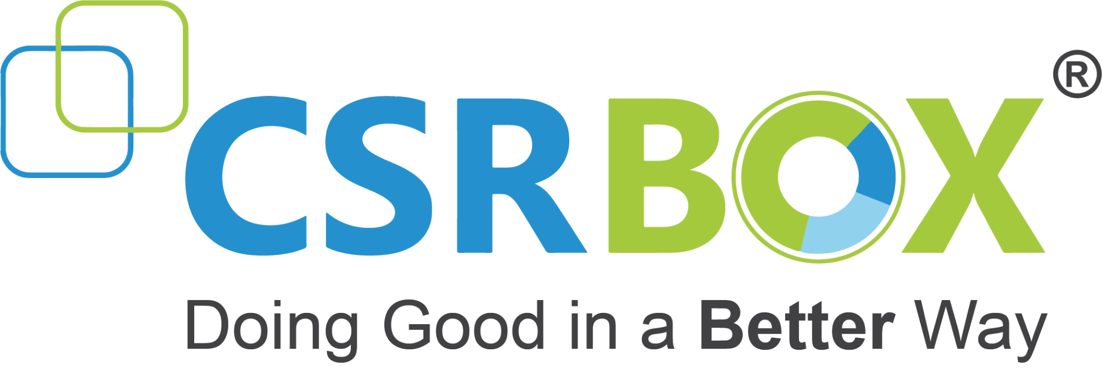
IBM SkillsBuild for Adult Learners - Data Analytics
Data Analytics Internship Program 2024 Final Project Presentation
Project Name : Gender Inequality Analysis and Solutions (SDG 5)
Unique ID : IBM1598 Team Name : Hackify
College Name : GSFC University

Slide 2
Team Members
NAME - EMAIL
Priyanka Joshi – 21bt04032@gsfcuniversity.ac.in
Riddhi Shah – 22bt04d162@gsfcuniversity.ac.in
Itisha Sakhreliya - 21bt04108@gsfcuniversity.ac.in
Khushi Patel – 21bt04079@gsfcuniversity.ac.in
Shreya Pandya - 21bt04119@gsfcuniversity.ac.in
Jainee Shroff - 21bt04120@gsfcuniversity.ac.in

Slide 3
Introduction
Overview of the Project
The Gender Inequality Index (GII) is a measure reflecting inequality in achievement between women and men. This project aims to analyze the GII and its associated factors across different countries, using data from the United Nations Development Programme (UNDP). By examining this data, we can gain insights into gender disparities in various aspects such as education, labor force participation, and political representation.
Objectives
Understand the distribution and variation of gender inequality across countries.
Identify key factors contributing to gender inequality.
Explore the relationship between different socio-economic variables and the GII.
Provide actionable insights to help mitigate gender inequality.

Slide 4
Problem Identification
Problem Statement
Gender inequality remains a pervasive issue globally, impacting various aspects of life including education, health, labor market participation, and political representation.The Gender Inequality Index (GII) provides a comprehensive measure of gender disparity, but it is crucial to understand the underlying factors contributing to high GII scores in different countries.
Significance of the Problem
Addressing gender inequality is essential for achieving sustainable development and fostering inclusive societies.Gender inequality affects economic growth, social stability, and overall well-being.Reducing gender disparity can lead to improved outcomes in health, education, and economic participation for both women and men.

Slide 5
Data Collection
Relevant SDGs
Goal 5: Gender Equality Achieve gender equality and empower all women and girls.
Goal 3: Good Health and Well-being Ensure healthy lives and promote well-being for all at all ages, with a focus on maternal health and adolescent birth rates.
Goal 4: Quality Education Ensure inclusive and equitable quality education and promote lifelong learning opportunities for all, with an emphasis on female education.
Goal 8: Decent Work and Economic Growth Promote sustained, inclusive, and sustainable economic growth, full and productive employment, and decent work for all, with attention to female labor force participation.
Goal 10: Reduced Inequalities Reduce inequality within and among countries, focusing on reducing gender inequality.

Slide 6
Data Preprocessing
Sources of Data
United Nations Development Programme (UNDP) : The Gender Inequality Index (GII) data is sourced from the UNDP’s Human Development Reports.
World Bank : Additional socio-economic indicators were obtained from the World Bank's open data repository.
National Statistical Offices : Specific country-level data were supplemented by national statistical offices where available.

Slide 7
Data Preprocessing
Data Description
Gender Inequality Index (GII) : Measures gender disparities in reproductive health, empowerment, and economic activity.Composite index that reflects inequality in achievements between women and men.
Reproductive Health Indicators : Maternal mortality ratio and adolescent birth rates.
Empowerment Indicators : Proportion of parliamentary seats held by women and the proportion of adult women and men aged 25 years and older with at least some secondary education.
Labor Market Indicators : Labor force participation rate for women and men aged 15 years and older.

Slide 8
Data Preprocessing
Data Collection Methods
United Nations Development Programme (UNDP) : Data collected through national surveys and international databases. Regular updates and validation processes ensure data accuracy and reliability.
World Bank : Data sourced from internationally recognized sources, such as the International Labour Organization (ILO) and UNESCO. Regular data collection and updating cycles.
National Statistical Offices : National surveys and censuses conducted periodically. Data verified and validated by respective governments and international bodies.

Slide 9
Data Preprocessing
Data Cleaning Methods
Standardization: Ensuring all data follows a consistent format.
Duplicate Removal: Identifying and removing redundant records.
Outlier Detection: Using statistical methods to address outliers.
Normalization: Adjusting values to a common scale.
Handling Missing Values
Identification: Detecting missing values in the dataset.
Mean/Median Imputation: Replacing with the column’s mean or median.
Mode Imputation: Using the most frequent value for categorical data.
Regression Imputation: Predicting missing values with regression models.
Removal: Deleting records with missing values if they are few and non-critical.

Slide 10
Data Preprocessing
Data Transformation Techniques
Normalization: Scaling data within a specified range, usually 0 to 1.
Standardization: Transforming data to have a mean of 0 and a standard deviation of 1.
Encoding Categorical Variables
One-Hot Encoding: Converting categories into binary vectors.
Label Encoding: Assigning each category an integer value.
Log Transformation: Applying logarithmic transformation to reduce skewness.Feature Engineering: Creating new features to improve model accuracy.

Slide 11
Data Analysis
Analytical Tools and Methods Used
Programming Language: Python, for data manipulation and analysis.
Pandas: For data handling and manipulation.
NumPy: For numerical operations.
Matplotlib & Seaborn: For data visualization.
Scikit-learn: For machine learning and statistical analysis.
Descriptive Statistics: Mean, median, mode, standard deviation.
Inferential Statistics: Hypothesis testing, regression analysis.
Supervised Learning: Regression and classification models.
Unsupervised Learning: Clustering algorithms like K-Means.

Slide 12
Data Analysis
Key Findings
The analysis revealed significant gender disparities in socio-economic indicators, with higher education, better health outcomes, and increased female labor force participation strongly correlating with reduced gender inequality. Targeted policies in these areas are essential to address and mitigate these disparities.
Insights Derived
Education Impact: Higher education levels in women correlate with reduced gender inequality.
Health Indicators: Improved health outcomes are associated with lower gender inequality.
Economic Participation: Increased female labor force participation leads to lower gender inequality.
Policy Implications: Need for targeted policies focusing on education, health, and economic opportunities for women to reduce gender inequality effectively.

Slide 13
Hypothesis Development
Formulated Hypothesis
The hypothesis posits that improving access to education and healthcare for women will significantly reduce gender inequality in socio-economic outcomes.
Rationale Behind the Hypothesis
This hypothesis is grounded in the belief that education and health are foundational pillars for empowering women, which in turn can lead to enhanced economic opportunities and equitable social conditions.
Method for Testing the Hypothesis
The hypothesis was tested using statistical analysis of gender inequality indices, educational attainment levels, and health metrics from various countries to observe correlations and causal relationships.

Slide 14
Solution Design
Proposed Solution
he proposed solution involves implementing targeted educational programs and healthcare initiatives aimed at empowering women and reducing gender disparities.
Implementation Plan
The plan includes collaboration with local governments and NGOs to establish educational scholarships and health clinics, ensuring sustainable and scalable impact over the next five years.
Alignment with SDGs
This solution directly aligns with SDG 5 (Gender Equality) and SDG 3 (Good Health and Well-being), promoting equitable access to education and healthcare for women.

Slide 15
Visualization
Data Visualization Techniques Used
Various techniques including bar charts, line graphs, and geographical maps were employed to represent the data visually.
Charts, Graphs, Maps, etc
Bar charts highlighted gender disparities in education and employment
line graphs showed trends over time
geographical maps illustrated regional variations in gender inequality.
Key Visual Insights
isualizations revealed significant disparities in education access between urban and rural areas and a consistent gender gap in employment rates across all regions analyzed.

Slide 16
Conclusion
Summary of Findings
The analysis highlighted substantial gender inequality in various domains, particularly in education and employment, with marked regional disparities. These findings underscore the urgent need for targeted interventions to bridge these gaps.
Impact of Proposed Solution
Implementing the proposed solution is expected to significantly reduce gender disparities, particularly by improving access to education and employment opportunities for women, thereby fostering greater gender equality and contributing to socioeconomic development.
Future Work
Future efforts should focus on continuous monitoring of gender inequality trends, evaluating the effectiveness of implemented solutions, and exploring additional areas such as health and political participation to further address gender disparities.

Slide 17
References
Data Sources
The primary data source used in this project is the Gender Inequality Index (GII) dataset, which provides comprehensive data on gender disparities in various domains across different countries.
Tools and Software Used
Analytical tools such as Python, pandas, and Matplotlib were used for data cleaning, analysis, and visualization. Additionally, IBM Watson Studio was employed for advanced analytics and model building.
Additional References
World Bank Gender Data
Scholarly articles on gender inequality from Google Scholar
Official statistics from national and international organizations
UNDP Human Development Reports

